Slide 1
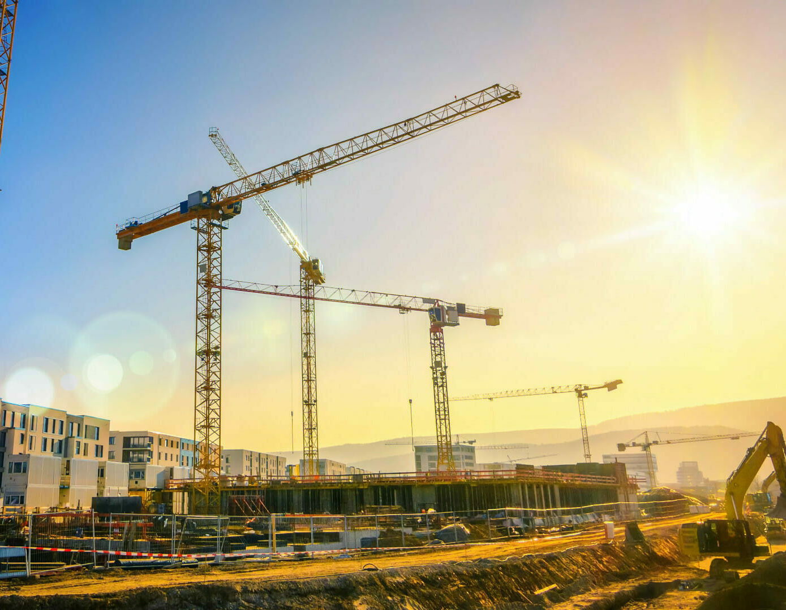


Identification of Construction / Crane Locations on High-Resolution Ortho-photos
Advanced Deep Learning Programming
EAGLE M.Sc. – Summer Semester 2024 Lecturer: Jakob Schwalb-Willmann
Presenters: Henning Riecken, Georg Starz
henning.riecken@stud-mail.uni-wuerzburg.de, georg.starz@stud-mail.uni-wuerzburg.de
17/11/24
https://www.deutsche-thermo.de/wp-content/uploads/2022/05/Nachhaltige-Baustelle-skaliert-e1653649780821.jpg
Notes:
H

Slide 2
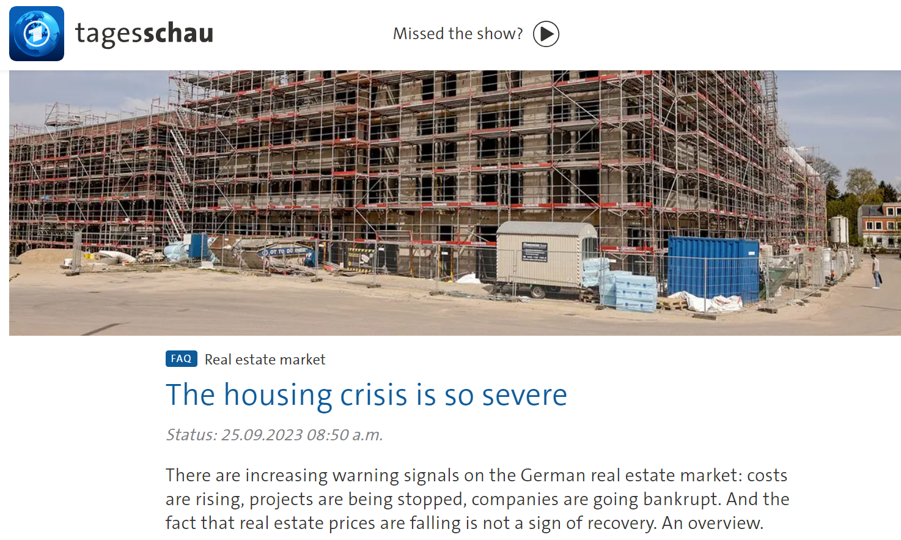
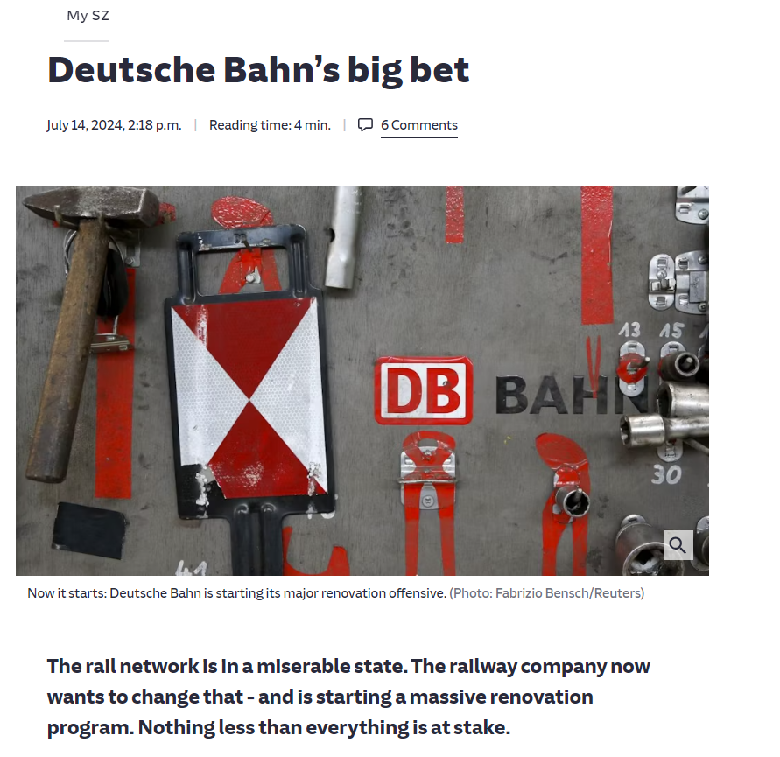
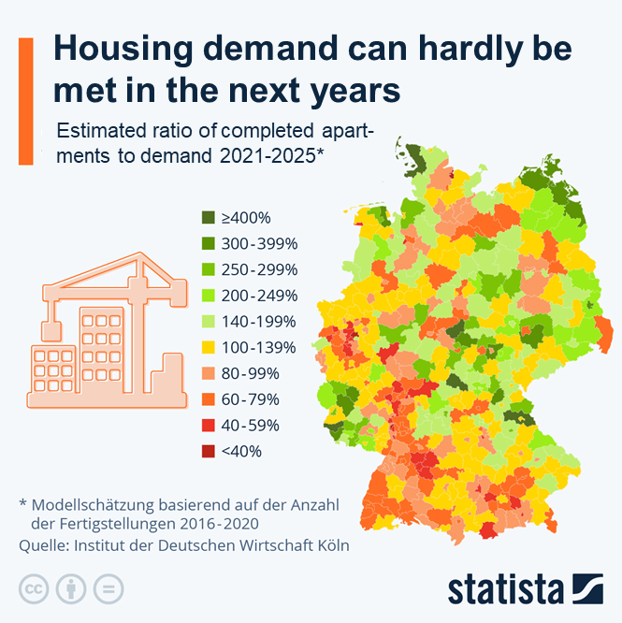
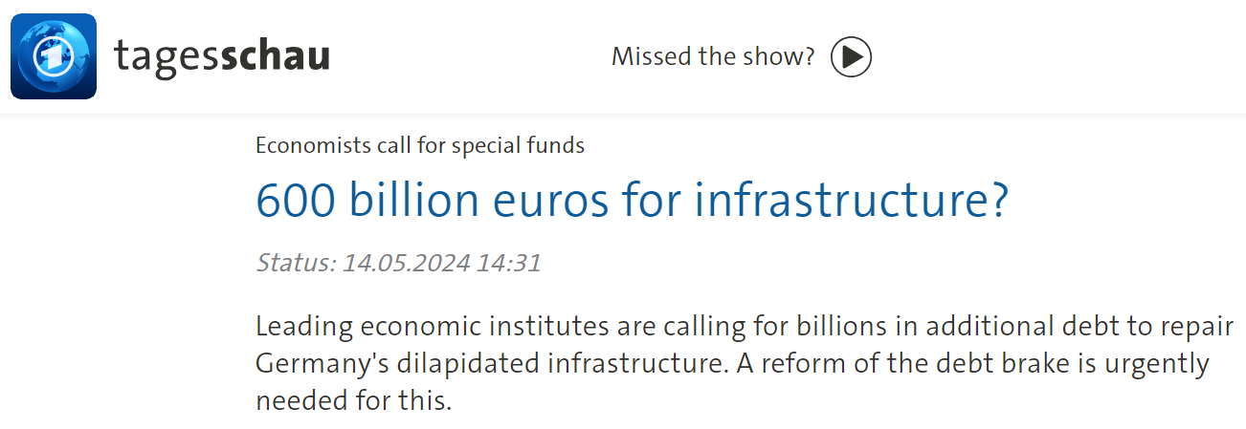
https://www.tagesschau.de/wirtschaft/verbraucher/immobilienmarkt-ueberblick-wohngipfel-100.html
Is it possible to reliably recognize, classify, and monitor construction sites from airborne and spaceborne data?
https://www.sueddeutsche.de/wirtschaft/deutsche-bahn-generalsanierung-kosten-zeitplan-lux.YZoUUNJgukgxoZQ4N1QqsR?reduced=true
https://de.statista.com/infografik/29160/verhaeltnis-fertiggestellter-wohnungen-zum-bedarf-2021---2025/
https://www.tagesschau.de/wirtschaft/konjunktur/infrastruktur-modernisierung-sondervermoegen-100.html
Notes:
H
Motivation (fast)

Slide 3
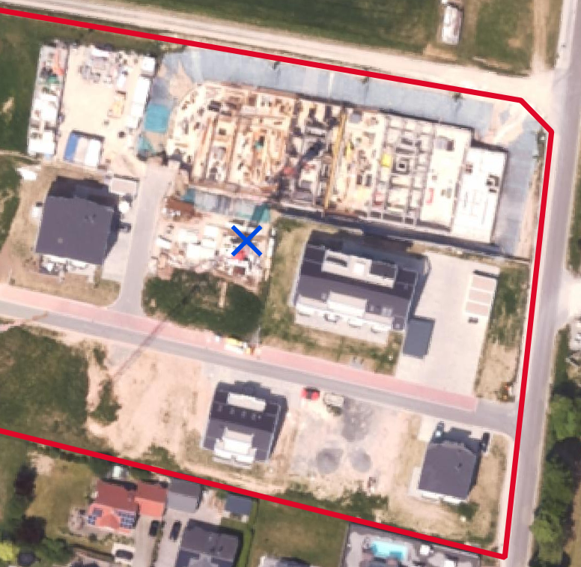
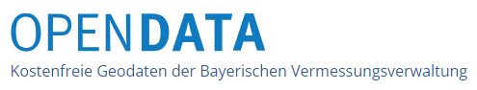

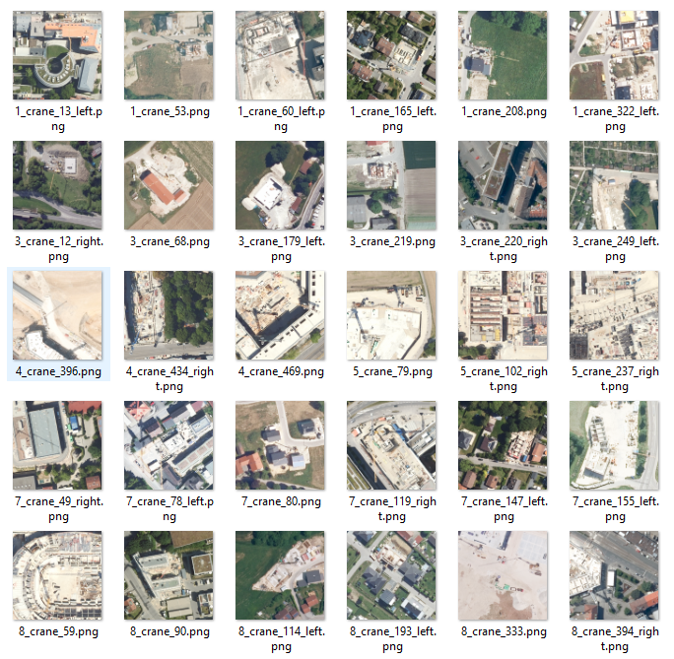
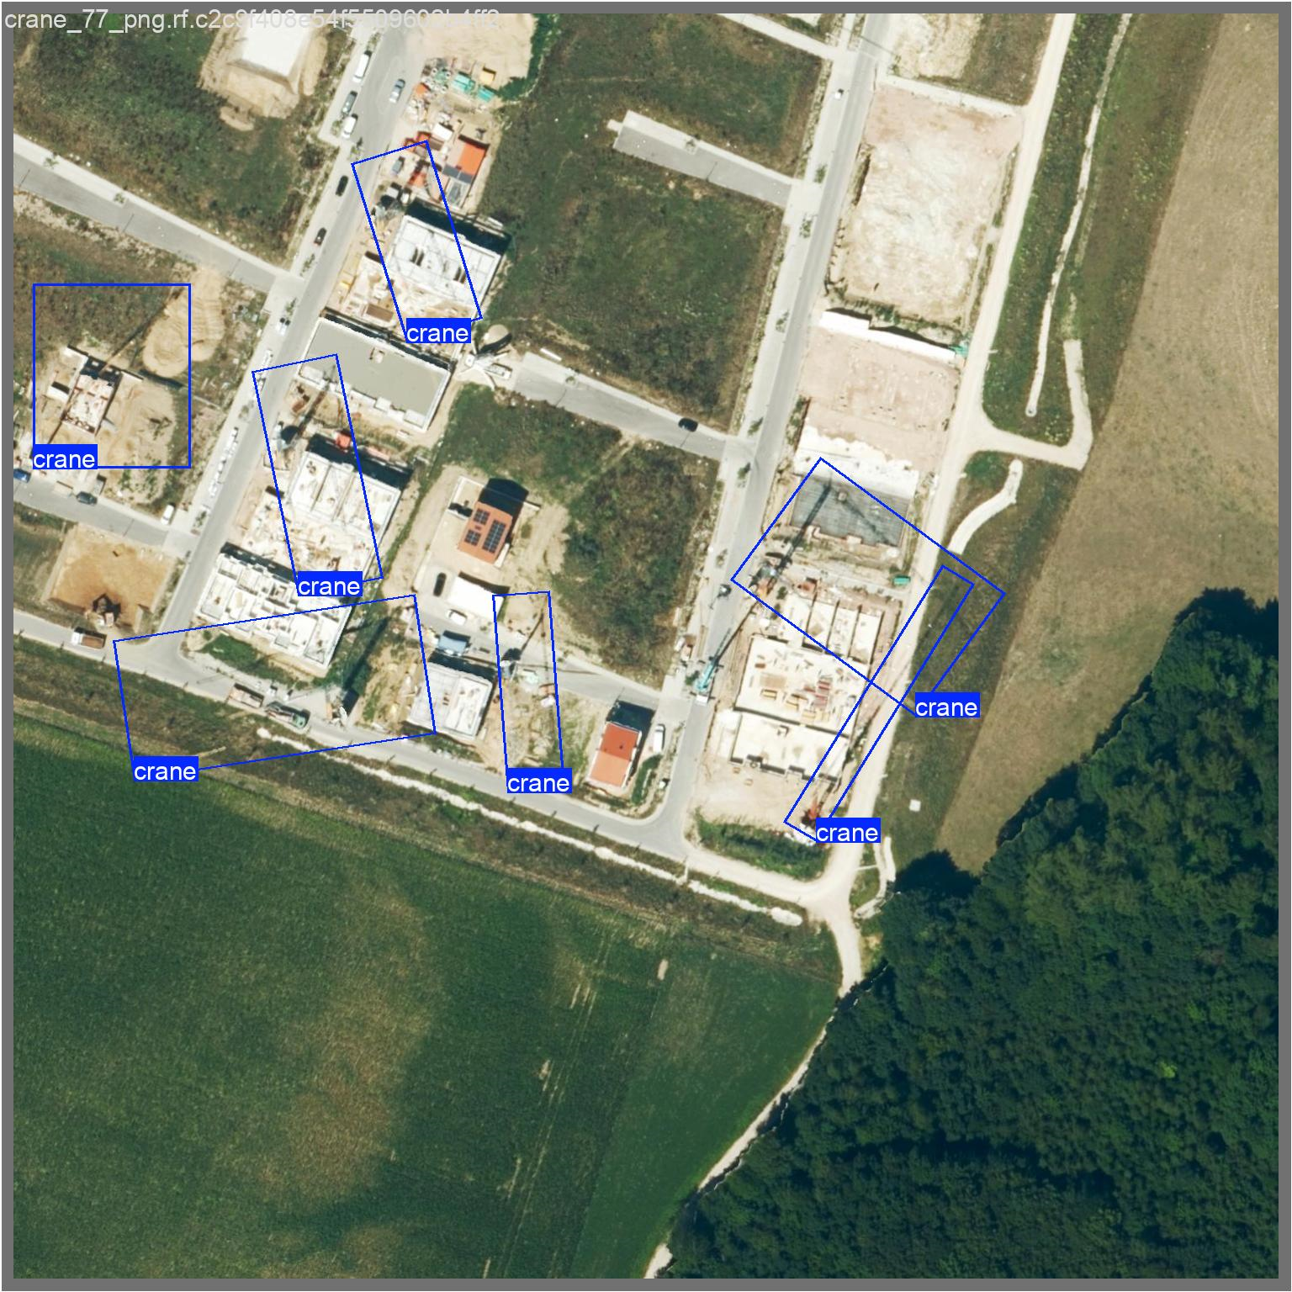
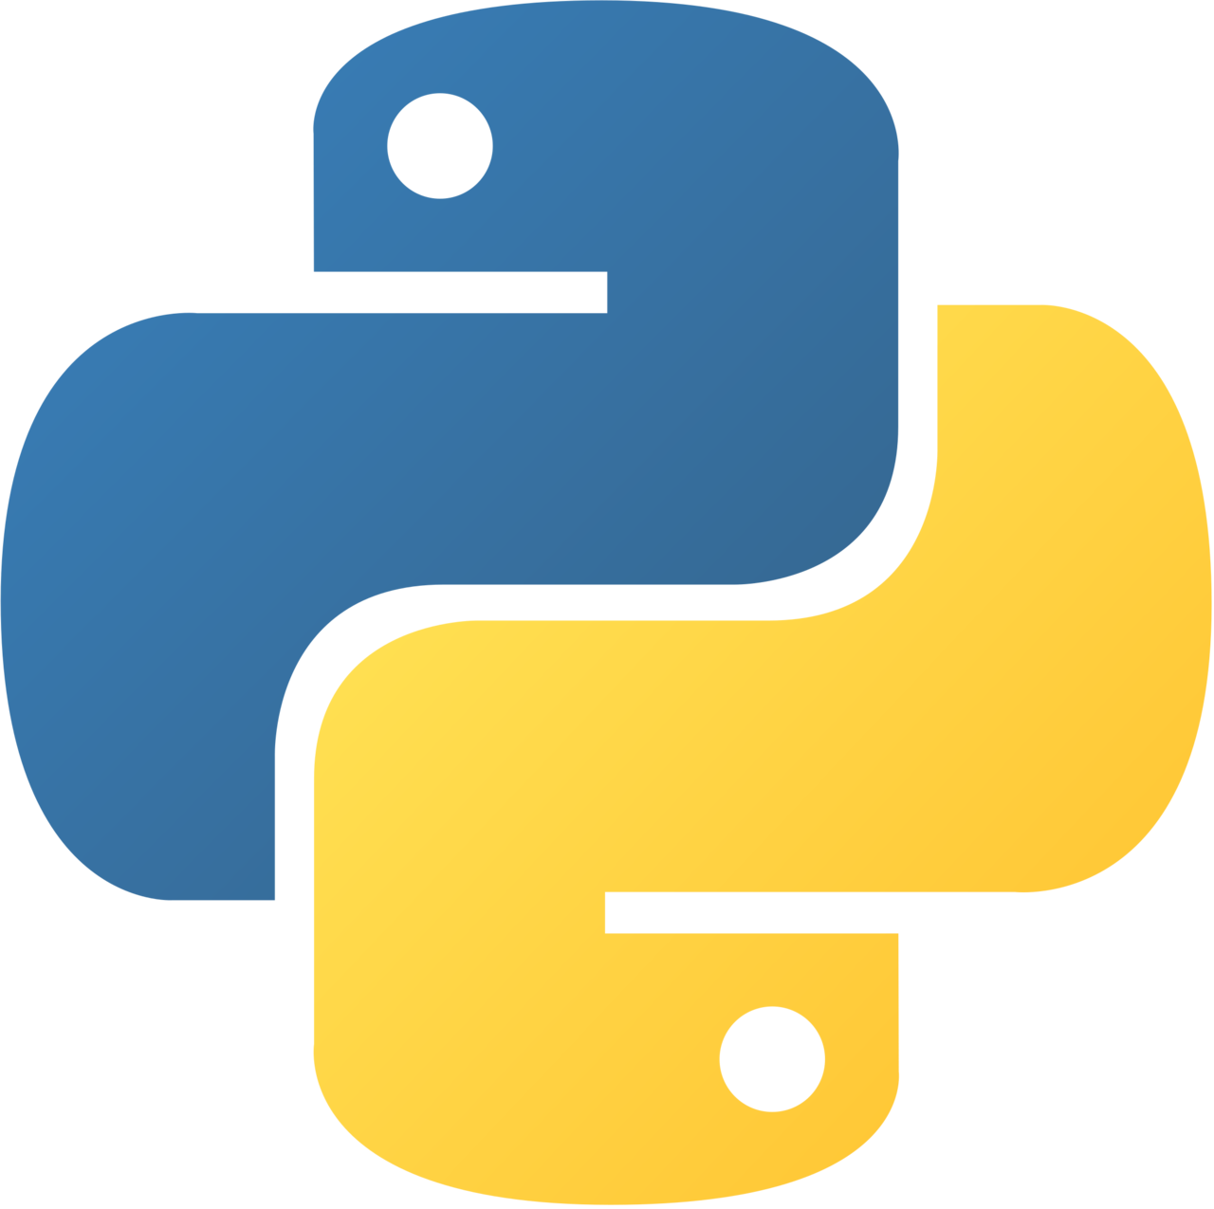


Input Data & Preprocessing
Deep Learning Model Trainings
Digital orthophoto, reso-lution: 20 cm (DOP20)
→ Finding and marking construction site locations with cranes
OSM tag „Construction“
Automatic download of images from DOP20 Web Map Service (WMS) with customizable size in meters and pixels
Oriented Bounding Box (OBB) object detection attempt → Poor results due to lack of computing capacity
Notes:
H
Initial idea: detection of cranes
Seems like complex task -> use existing DL model architecture
Why OBB?

Slide 4
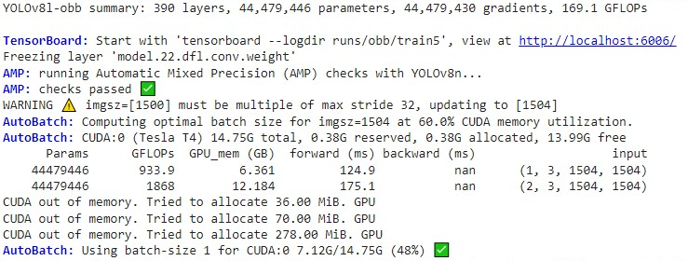
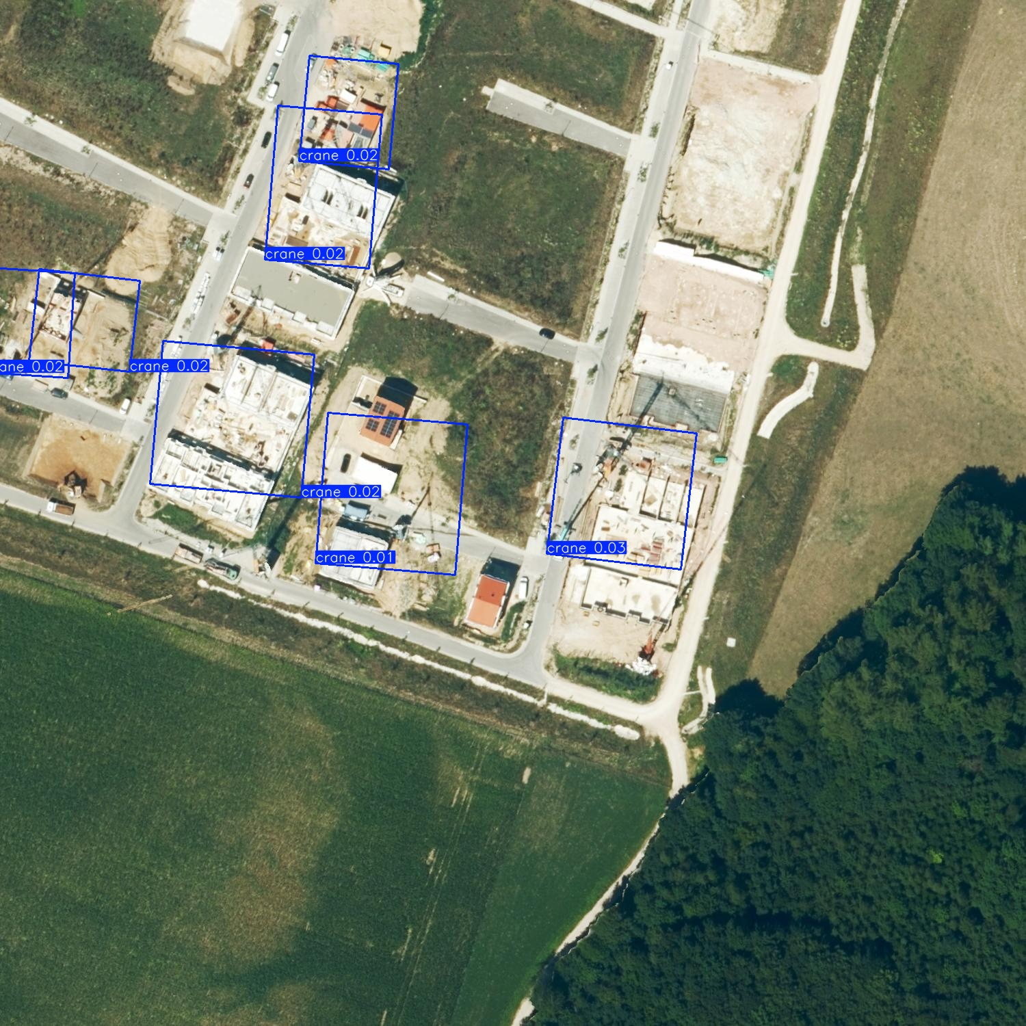
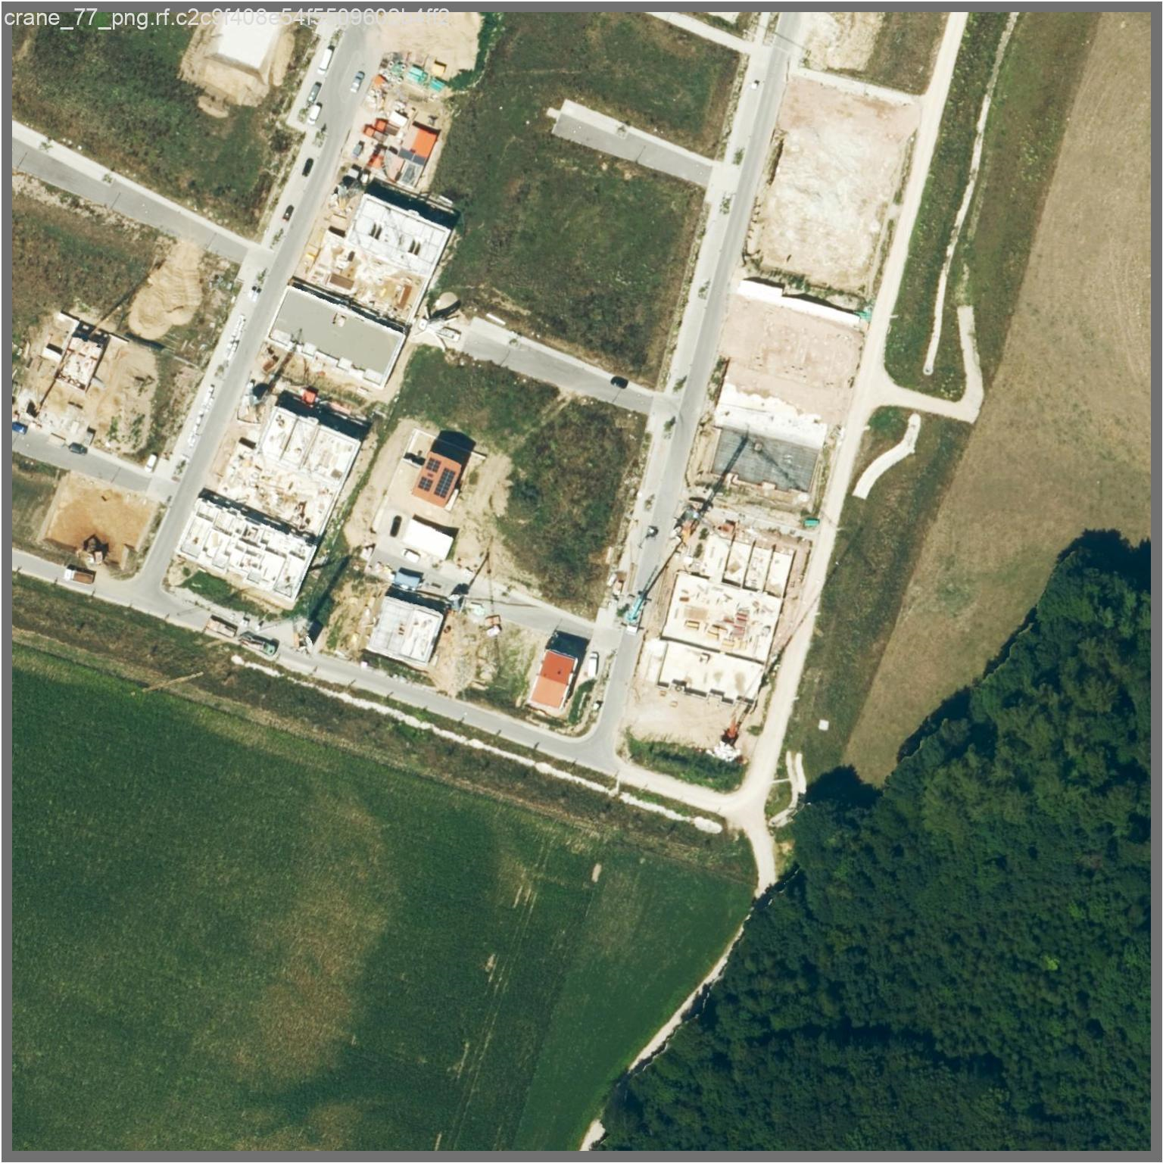
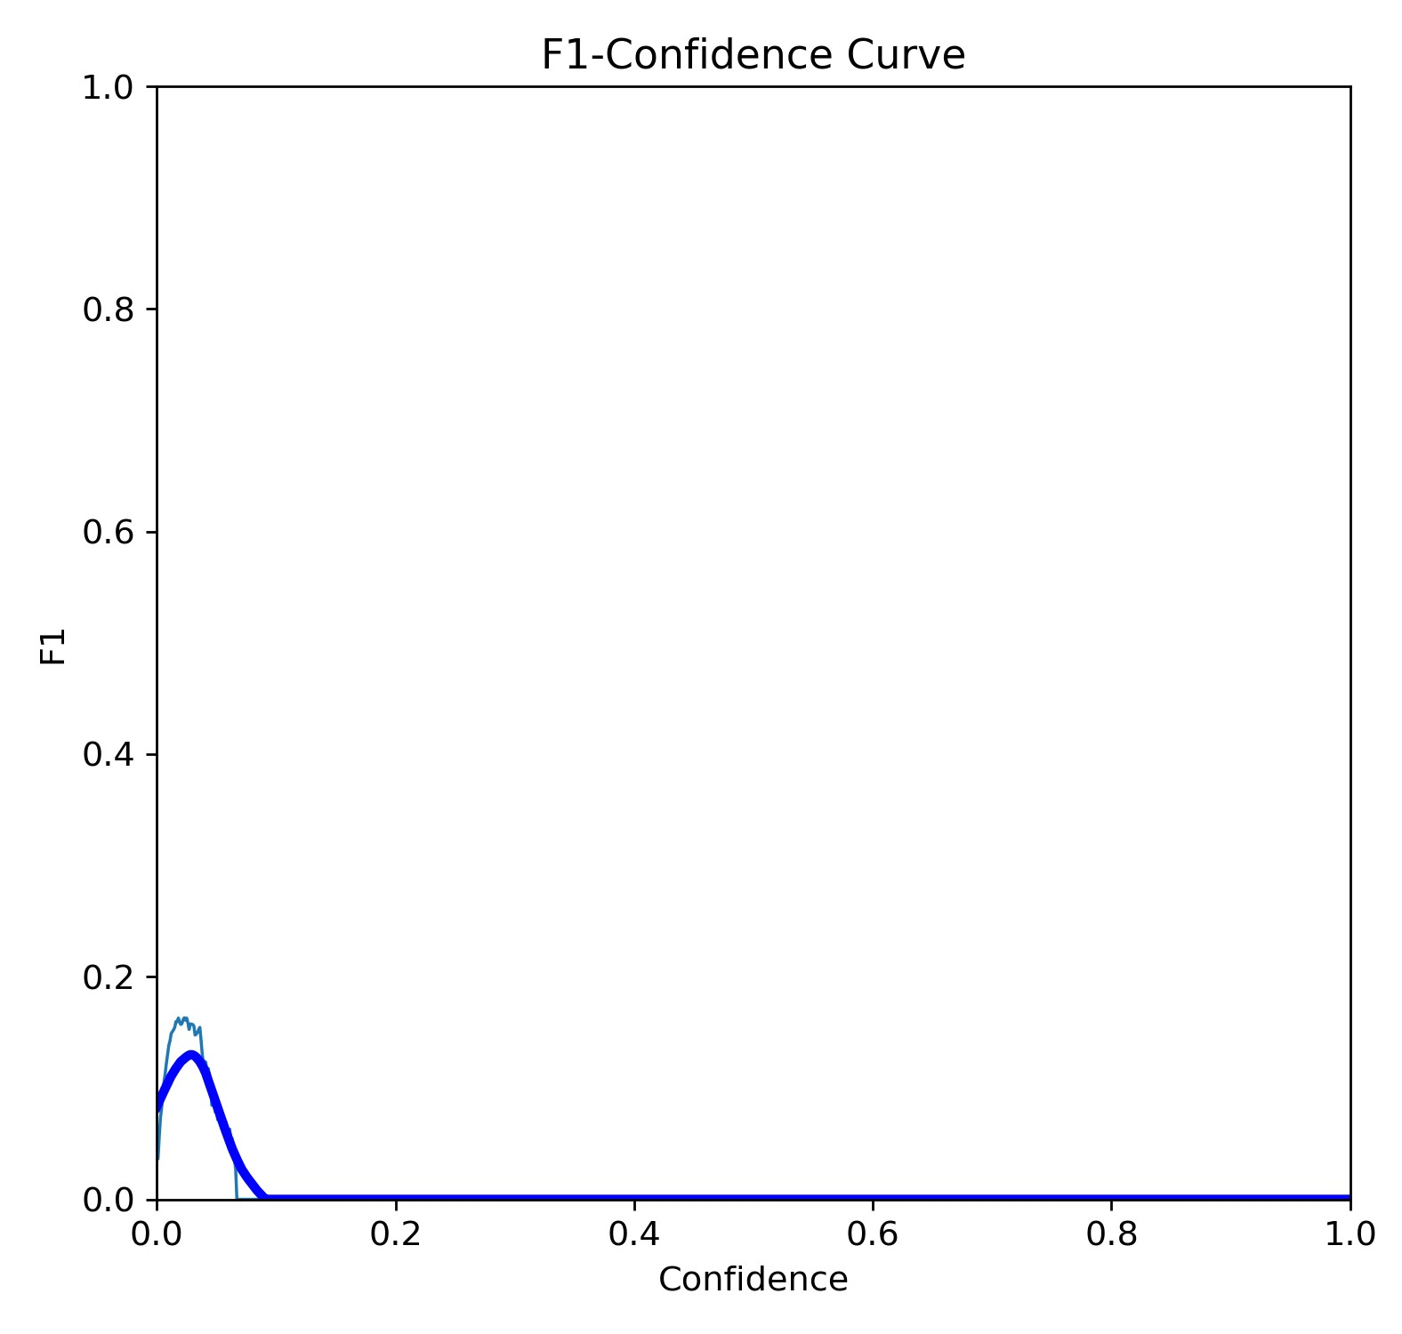
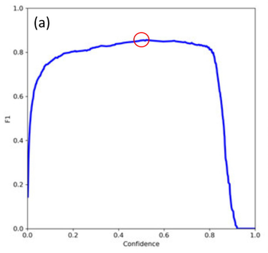
Oriented Bounding Box (obb) Detection – YOLOv8-obb
343 images
Image size: 300 m x 300 m / 1500 x 1500 Pix
Roboflow for labeling
647 cranes
Augmentation: 90° Rotation → Clockwise & Counter-Clockwise
Train/Val/Test split: 84/10/6 %
a)
Fig.1: An examplary image of a construction site with a) manually drawn obb labels and the YOLOv8l-obb predictions with a confidence of b) 0.5 (none) and c) 0.01.
Fig.2: The YOLOv8l-obb summary output when starting the training.
a)
b)
Hansen et al. (2022)
c)
b)
Fig.3: a) The YOLOv8l-obb F1-Confidence Curve of our model and b) a curve representing a more successful model training.
Notes:
H
We labeled crane & shadow

Slide 5
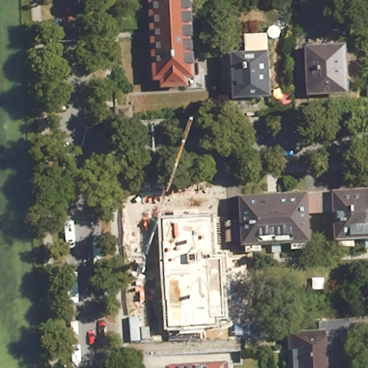
Input Data & Preprocessing
Deep Learning Model Trainings
Digital orthophoto, reso-lution: 20 cm (DOP20)
→ Finding and marking construction site locations with cranes
Construction vs. No construction
Classification task
→ Training less computationally intensive
→ Two model trainings that ran for a few hours
OSM tag „Construction“
Automatic download of images from DOP20 Web Map Service (WMS) with customizable size in meters and pixels
Oriented Bounding Box (OBB) object detection attempt → Poor results due to lack of computing capacity
Notes:
COMPUTING CAPACITY WAS LACKING!
No construction: random images from bavarian cities

Slide 6
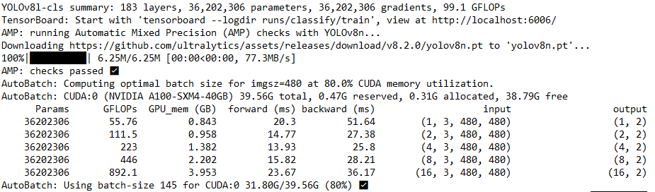
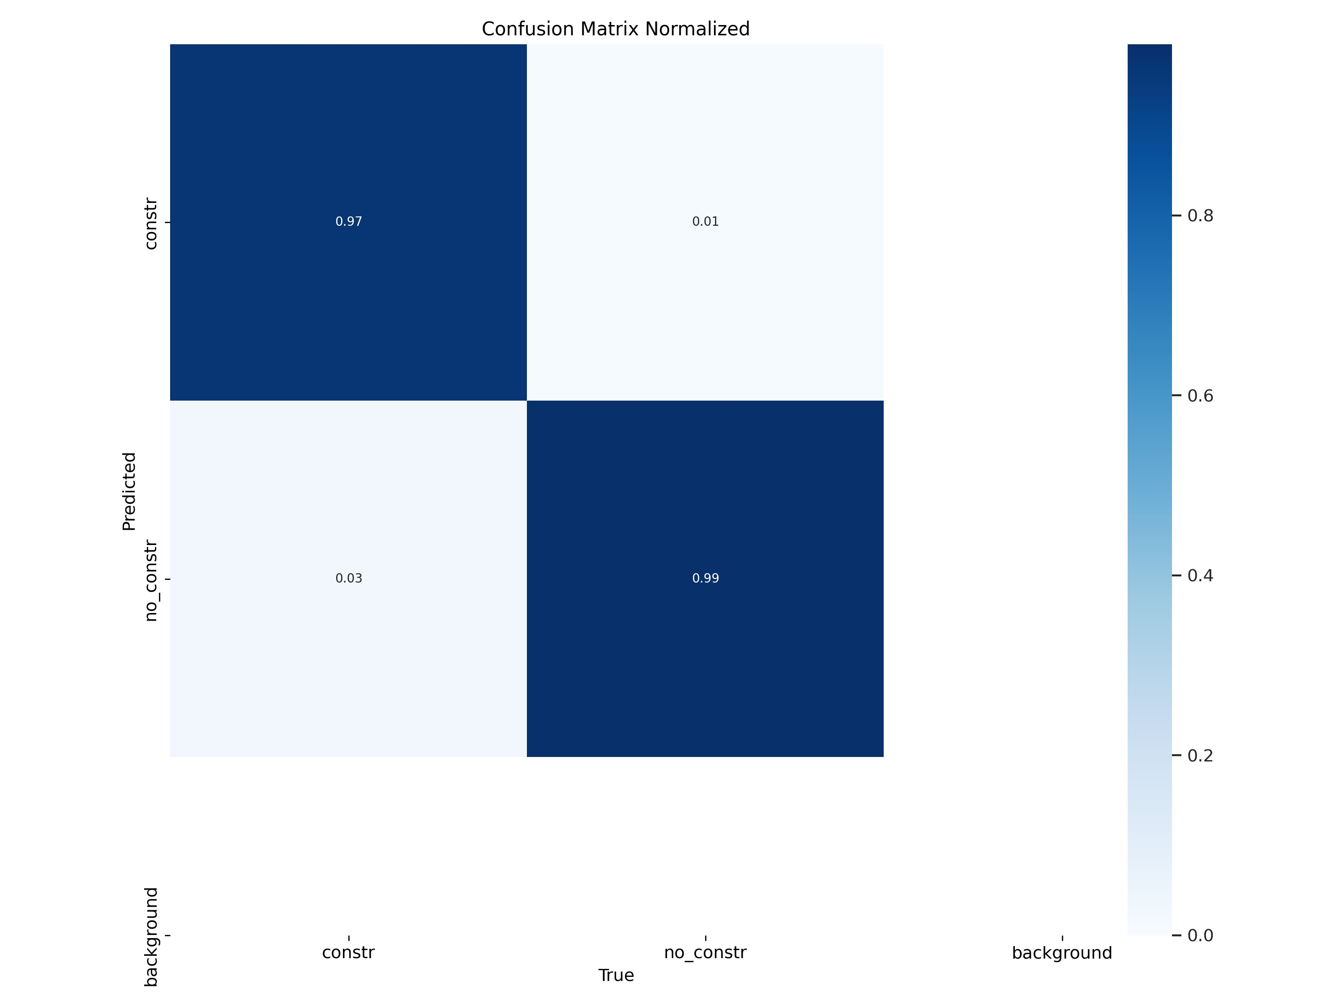
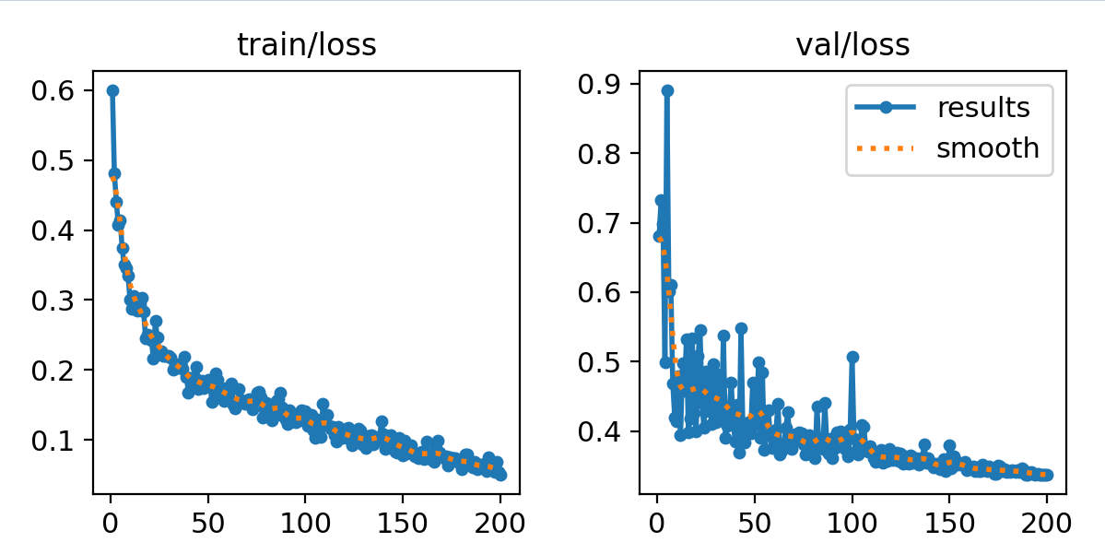
Image Classification – YOLOv8-cls
1191 images (495 construction / crane, 696 no constr. / crane)
Image size: 96 m x 96 m / 480 x 480 Pix
Augmentation: 90° Rotation → Clockwise & Counter-Clockwise
Train/Val/Test split: 60/30/10 %
Fig.4: The YOLOv8l-cls summary output when starting the training.
Fig.5: The Normalized Confusion Matrix of the validation data indicating a high classification accuracy of the model.
Fig.6: The loss graphs of the Yolov8m-cls model showing declining & stabilizing loss of the model over the epochs.
Notes:
M: 200 ep
L: 400 ep

Slide 7
Results – Test 1
Tables 1 & 2: Statistics 1. TP = True Positives,
FP = False Positives,
TN = True Negatives,
FN = False Negatives, conf = mean model confidence.
Very promising results, but models have seen most test images in augmented form during training. How do they perform on completely unseen data?
Notes:
G
Augmentation leider vor Split durchgeführt

Slide 8
Results – Test 2 (new, completely unseen data)
Tables 3 & 4: Statistics 2. TP = True Positives, FP = False Positives, TN = True Negatives, FN = False Negatives, conf = mean model confidence.
Results still quite good, but what about construction sites without cranes?
→ Performance decreases
Notes:
Neue Testdaten, 106 Bilder
BW Daten inkludiert

Slide 9
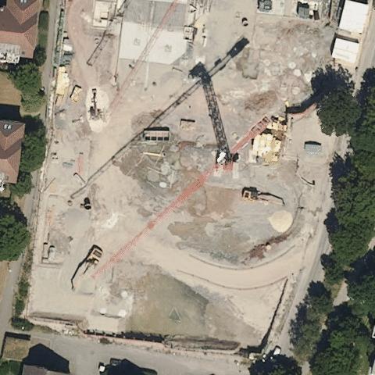
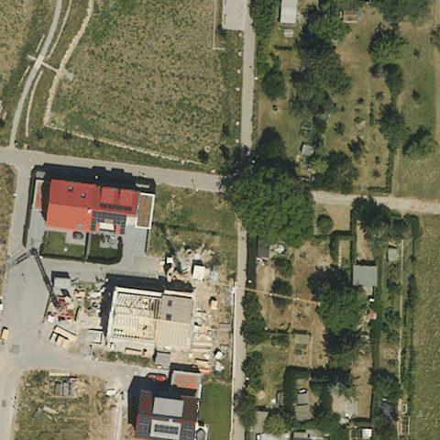
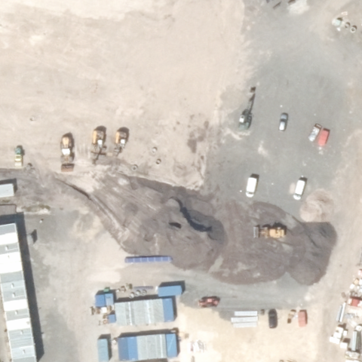
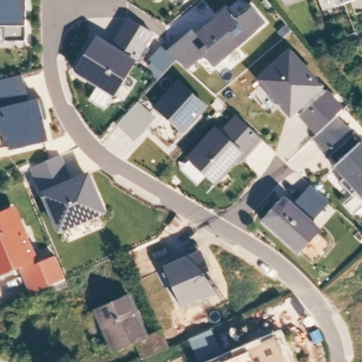
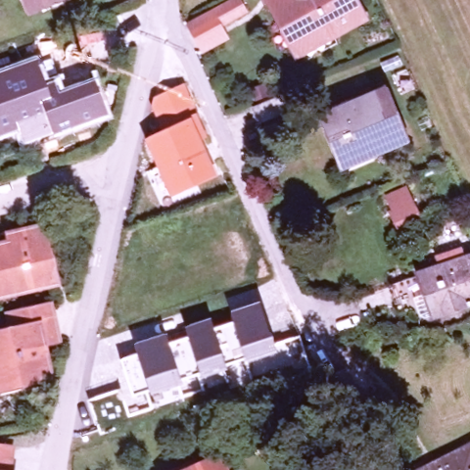
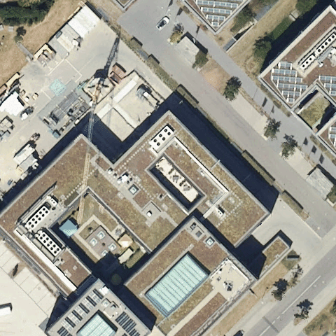
Results – Test 2 Example Images
0,99
0,64
0,98
TP
0,00
0,00
0,39
FN
Fig.7: Example images of TPs (green contour) and FNs (red contour), including confidence values

Slide 10
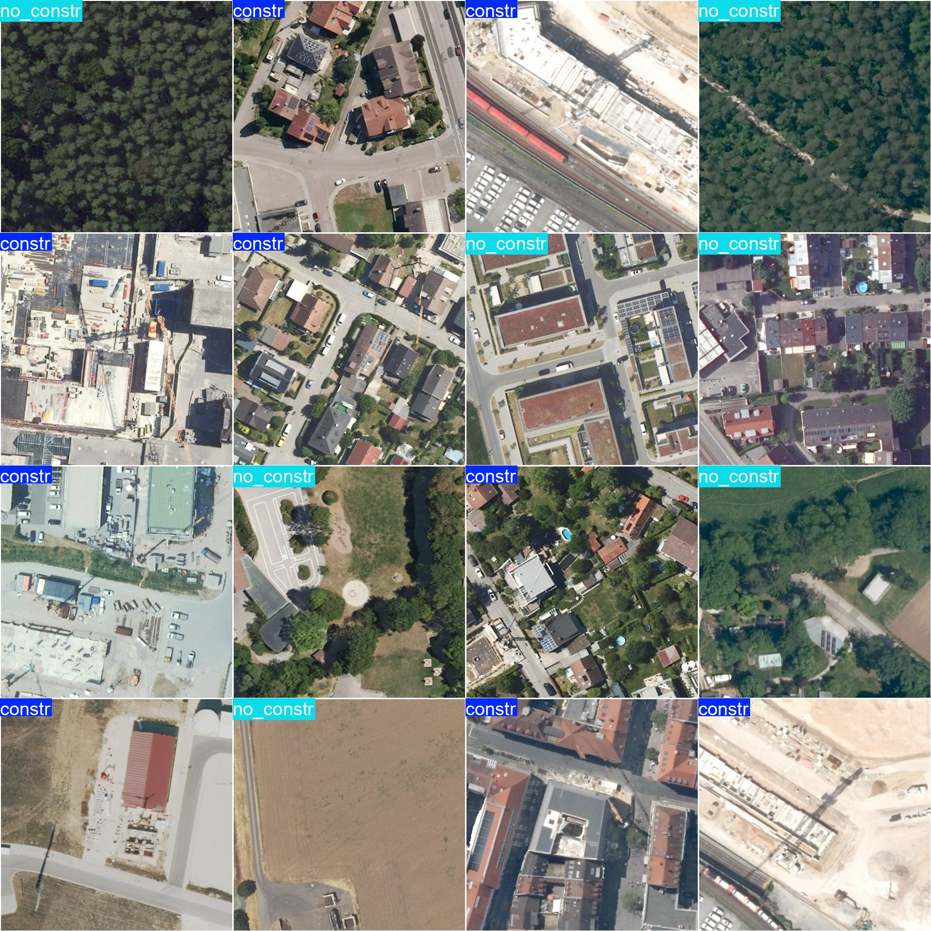
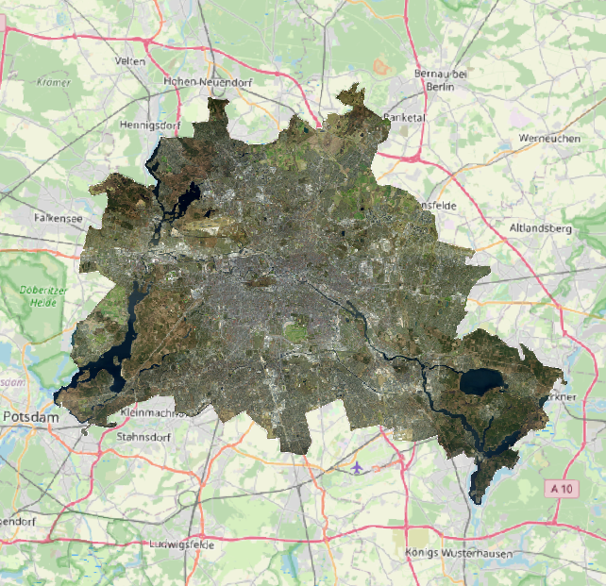
Input Data & Preprocessing
Deep Learning Model Trainings
Results & Application
Digital orthophoto, reso-lution: 20 cm (DOP20)
→ Finding and marking construction site locations with cranes
Construction vs. No construction
Classification task
→ Training less computationally intensive
→ Two model trainings that ran for a few hours
Promising results
→ Models tested on two different data sets
→ F1: 0.89-0.97
→ How important are construction cranes for model performance?
OSM tag „Construction“
Automatic download of images from DOP20 Web Map Service (WMS) with customizable size in meters and pixels
Oriented Bounding Box (OBB) object detection attempt → Poor results due to lack of computing capacity
Applying one model to entire DOP20 of Berlin
→ Further insights into performance → Helpful for upcoming model trainings?

Slide 11
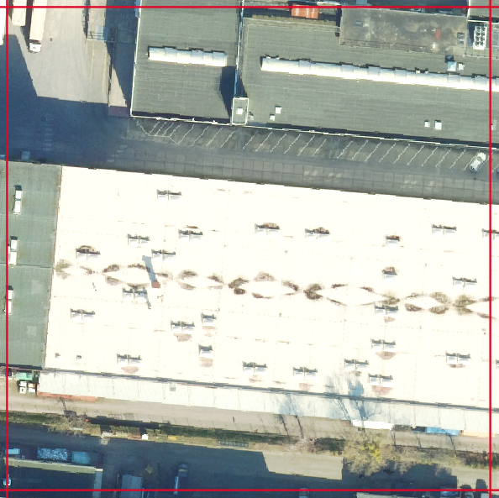
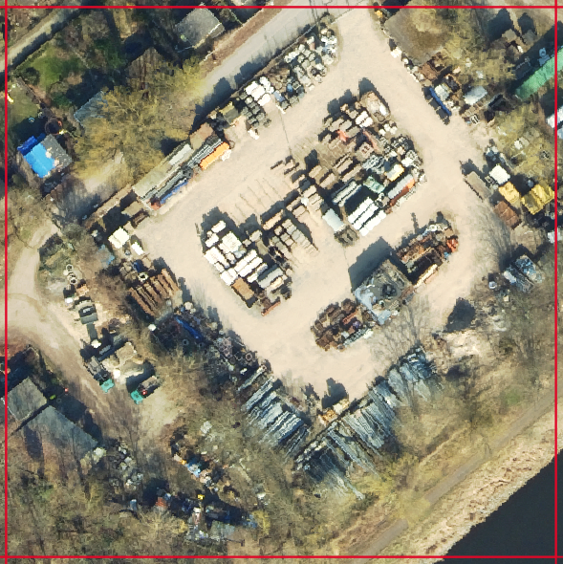
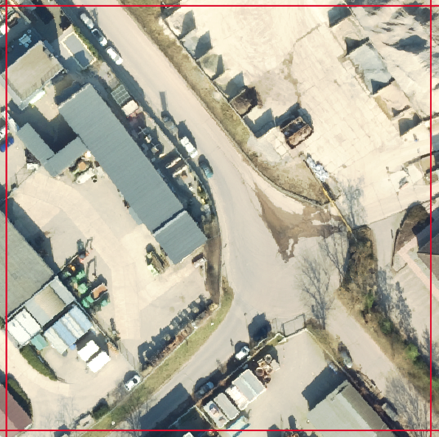
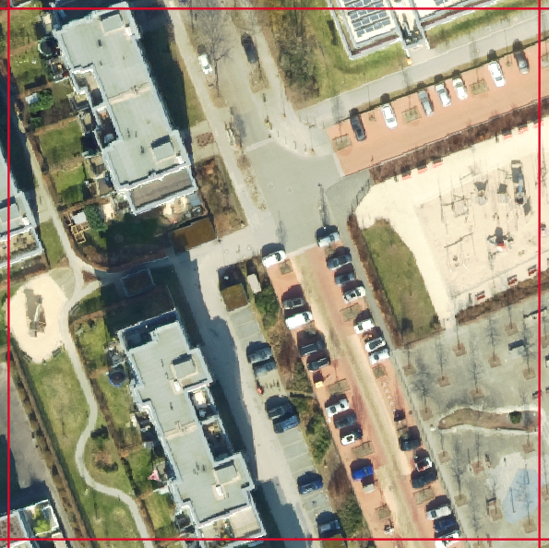
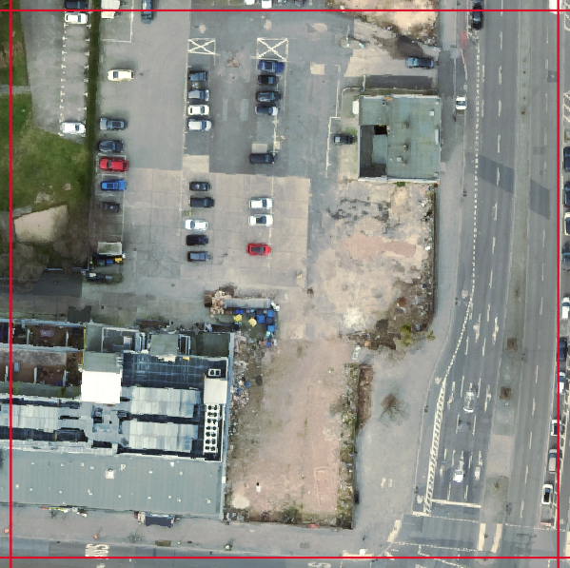
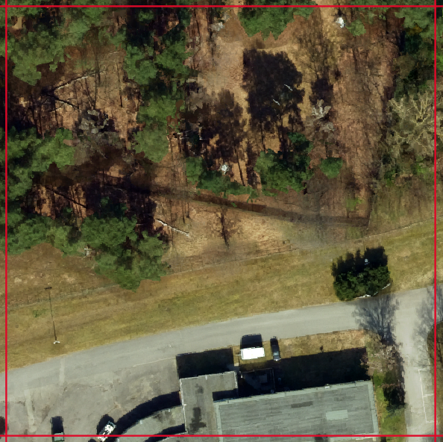
Application – DOP20 Berlin 2024
Models easily transferable and applicable on a large scale?
At first glance, less promi-sing results than in tests
Medium Model seems to work better than large one
16944 of 96633 tiles labeled as construction site (conf > 0.5) → 17.5 % → Over-estimation ?!
Causes of errors cannot be derived precisely
Valuable for upcoming model trainings: training data creation simplified & more precise
a)
b)
c)
d)
e)
f)
Fig.8: Example images of FPs with a high conf value when applying the Medium Model and assumptions about the causes of errors: a) Roof structure similar to crane shadow; b) Scrap yard; c) Building yard; d) Playgrounds; e) Building gap; f) Hedge with similar shape to crane shadow.

Slide 12
Conclusions & Outlook
YOLOv8-obb model training too computationally extensive for our case study
Classification tasks require less computing power
The YOLOv8-cls models detect construction sites with cranes via a binary classification approach with high accuracy
But: Blackbox character of NNs remains → especially for large, pre-existing architectures like YOLOv8
Amount and structure of training data could be expanded
Training parameters could be fine-tuned in great detail → model size, batch size, learning rate, optimizer, loss functions, weight decay, early stopping, etc.
Incorporating satellite data into model training? → lower spatial resolution, higher temporal resolution
Exploring the possibilities to fuse the outcomes with other geodata? Further research questions?
Thank you for the attention! Questions? ☺

Slide 13
References, Further Literature & Links
Bayerische Vermessungsverwaltung (2024). Digitales Orthophoto (20cm) https://geodaten.bayern.de/opengeodata/OpenDataDetail.html?pn=dop20.
Bundesamt für Kartographie und Geodäsie (BKG) (2024). EO4ConStat. https://www.bkg.bund.de/SharedDocs/Stellenangebote/BKG/DE/240818-GD5_172024-EG13.html.
Computer Vision Engineer (2024). IMAGE CLASSIFICATION with Yolov8 custom dataset | Computer vision tutorial [Video]. YouTube. https://www.youtube.com/watch?v=ZeLg5rxLGLg.
Gui, S.; Song, S.; Qin, R.; Tang, Y. (2024). Remote Sensing Object Detection in the Deep Learning Era—A Review. Remote Sens. 16, 327. https://doi.org/10.3390/rs16020327.
Hansen, M.; Oparaeke, A.; Gallagher, R.; Karimi, A.; Tariq, F.; Smith, M. (2022). Towards Machine Vision for Insect Welfare Monitoring and Behavioural Insights. Frontiers in Veterinary Science. 9. 10.3389/fvets.2022.835529.
Landesamt für Geoinformation und Landentwicklung (2024). Digitale Orthophotos in Farbe 20 cm Bodenauflösung.
Nielsen, N. (2024). How to Train YOLOv8.1 on Custom Dataset with Oriented Bounding Boxes [Video]. YouTube. https://www.youtube.com/watch?v=UG4W3yBTJzM.
OWSLib (2023). Interact with a WMS. https://www.geoportal-bw.de/geonetwork/srv/ger/catalog.search#/metadata/4927a198-e9ce-da9a-a5ef-c11f21ff173f. https://owslib.readthedocs.io/en/stable/notebooks/wms.html.
Robin Cole (2024). Satellite Image Deep Learning. https://github.com/satellite-image-deep-learning/techniques?tab=readme-ov-file#object-detection.
Roboflow (2024). Everything you need to build and deploy computer vision models. https://roboflow.com/.
Senatsverwaltung für Stadtentwicklung, Bauen und Wohnen Berlin (2024). Digitale farbige TrueOrthophotos 2024 (DOP20RGBI). https://gdi.berlin.de/geonetwork/srv/ger/catalog.search#/metadata/de71f450-3059-3ba6-9965-39cc7173a56f.
Trimaille, E.; Gusty (2023). QuickOSM - QGIS Python Plugins Repository. Version 2.2.3. Plugin ID: 579. https://plugins.qgis.org/plugins/QuickOSM/#plugin-versions.
Ultralytics (2023): Brief summary of YOLOv8 model structure. https://github.com/ultralytics/ultralytics/issues/189.
Ultralytics (2024). YOLOv8. https://docs.ultralytics.com/.

